Slide 1

Azure IoT Security MXChip IoT & Azure Sphere MT3620
Wriju Ghosh
@wrijugh

Slide 2
Demo
Setting up MXCHIP

Slide 3
DEMO
Setting up Azure sphere MT3620

Slide 4
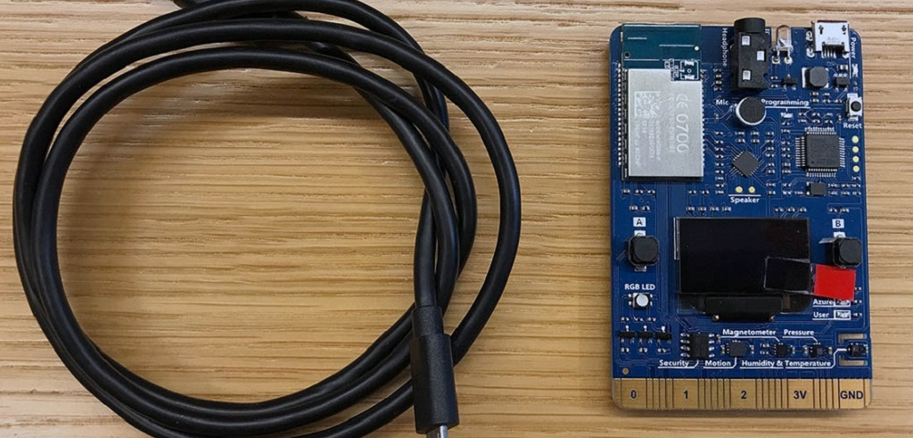

Slide 5
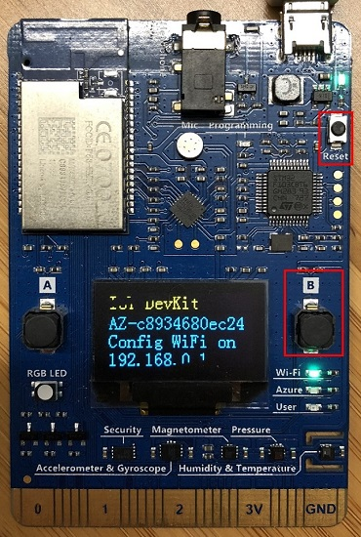
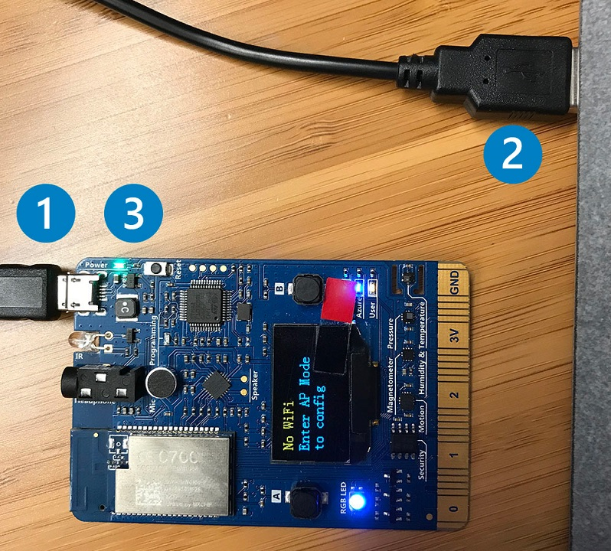

Slide 6
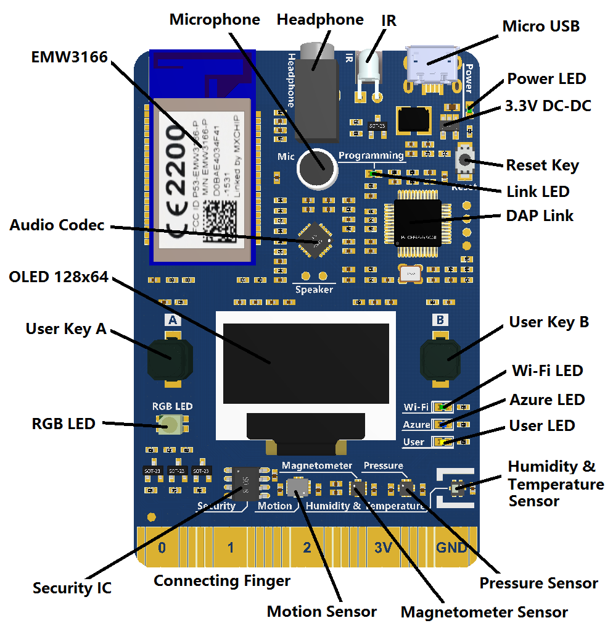

Slide 8
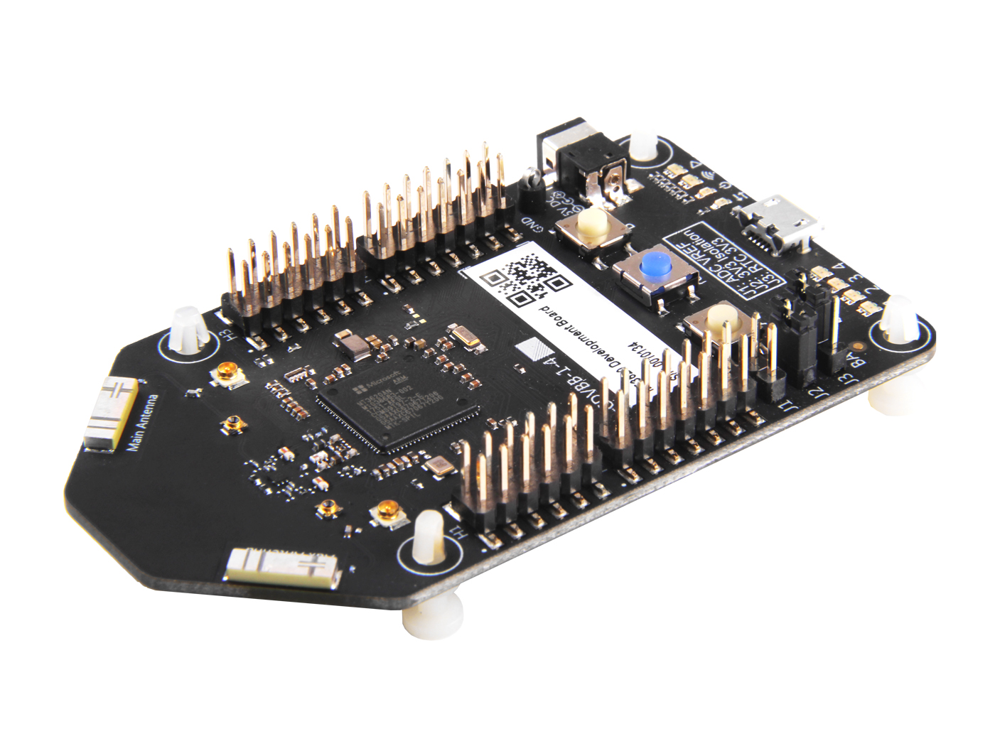
Azure Sphere MT3620
Now available
Azure Sphere development kits from Seeed studios
Availability
Azure Sphere OS
Azure Sphere Security Service
Visual Studio tools for Azure Sphere
Try today:: http://www.azure-sphere.com

Slide 9
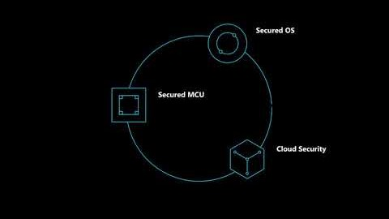

Slide 10
Contact @wrijugh
MXChip Devkit https://aka.ms/iot-devkit
Azure Sphere https://azure.microsoft.com/en-us/blog/introducing-microsoft-azure-sphere-secure-and-power-the-intelligent-edge/
Seven Properties of Highly Secure Devices
https://www.microsoft.com/en-us/research/publication/seven-properties-highly-secure-devices/

